Slide 1
BEST Program Communications
The BEST practices for
successful communication!

Slide 2
Topics
What is Communication?
Comms Function Goals
Working with BEST Comms
Comms Process
  When to seek comms support
  Approval flows
  Recommended lead times
  Who reviews, when, and why
Questions

Slide 3
What is Communication?

Slide 4

What is Communication?
Sharing or imparting information
From the Latin communicare: to make common
  Communication is not only about giving information. It is about fostering a shared understanding.
Part of all our jobs
Very difficult to do well!

Slide 5

Communication as a Business Function
An area of expertise
A targeted strategy for approaching and engaging stakeholders
A method to create alignment and understanding across teams

Slide 6





BEST Communications Function Goals
Keep Program stakeholders informed and engaged.
Guide program staff on communications best practices.
Maintain trust in the Program through consistency and integrity across messages.
Protect our audience’s time by:
sending messages to the right people at the right time
making sure content is clear, concise, and accurate

Slide 7
Communications Activities
Vehicles for Engagement
SharePoint
Transformation_PMO inbox
BEST Program website (public-facing)
Fact Sheets, FAQs
Content Development
Messaging
Writing
Editing
Formatting
Designing
Slide Decks
Agency Engagement
Monthly POC/TPOC newsletters
Targeted Emails (CTR Weekly)
Recruitment messaging for program activities (e.g. CAN, UAT)
Strategy/
Operations
Comms
Calendar maintenance
Message planning/execution
Managing review process
Workstream Support
Messaging prep & review
Outreach Distribution

Slide 8
Working with BEST Comms

Slide 9

Maybe you don’t want to engage comms because…
They don’t understand your work.
You know how to write/send an email/summon a carrier pigeon.
It takes too long to get approval.
Receiving feedback to integrate creates more work and you need to get things OFF your plate!

Slide 10

The Case for Comms
We don’t understand your work.
(Which means we can help you translate it.)
Our job is to make your work (and YOU!) look good and be as effective as possible.
We are trained experts in making content engaging and accessible.
We have a bird’s-eye view of all BEST Program activities. You stick with the trees, we’ll take the forest.

Slide 11
The WHY Behind the Process

Slide 12
Why put these processes in place?
Can’t we all send an email?
Every member of our team is an expert at what they do and is aiming to share accurate and up-to-date information!
However, within a project environment information can change rapidly, and we want to make sure everyone is on the same page.
These processes ensure that we, as a team and as a capital project, have access to who said what to whom.

Slide 13

Our goals in this process are to:
Ensure what we say is accurate and in alignment with what each workstream is doing.
Enable you to accomplish your goals by accurately communicating to your audience.
Keep an accurate record of what information has been distributed.
Maintain trust in the program by providing reliable information.

Slide 14
Comms Process/Workflow

Slide 15
Seek Comms Support if…
You’re sending something to a large or new group outside of BEST.
You’re presenting to an external stakeholder group.
  E.g. Comptroller/Asst. Comptrollers, FIEs, CAN
You have a new project activity coming up.
You would like help!

Slide 16
In general, working with the comms team will look like this:
    Got something to say?
    The comms team wants to know about it!
    Fill out the communications support form
    Comms will reach out to work with you on development
    Comms will solicit reviews + feedback from stakeholders
Some things we never need to see:
Your Teams messages/lunch plans
Emails to limited internal groups about specific work activities.
Note: Depending on your manager’s preferences, they may prefer you approach them with any requests before submitting to the comms team.

Slide 17
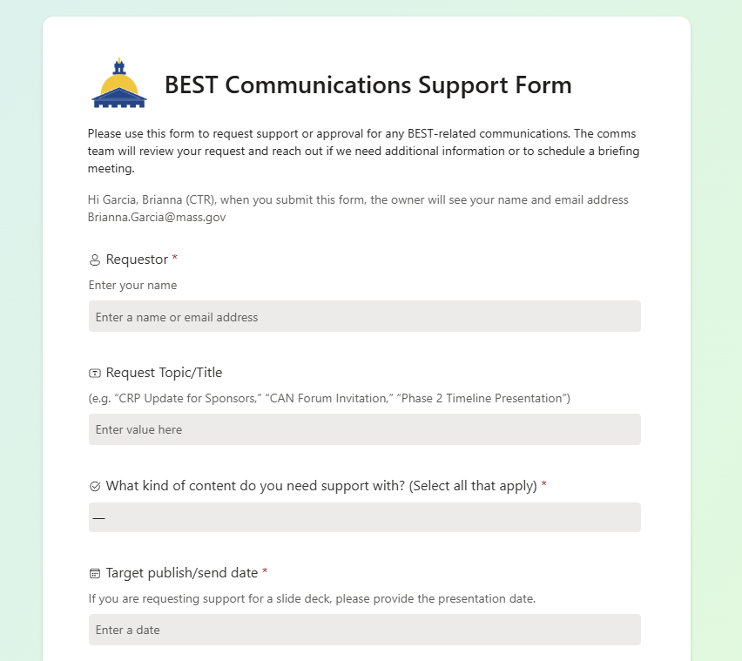
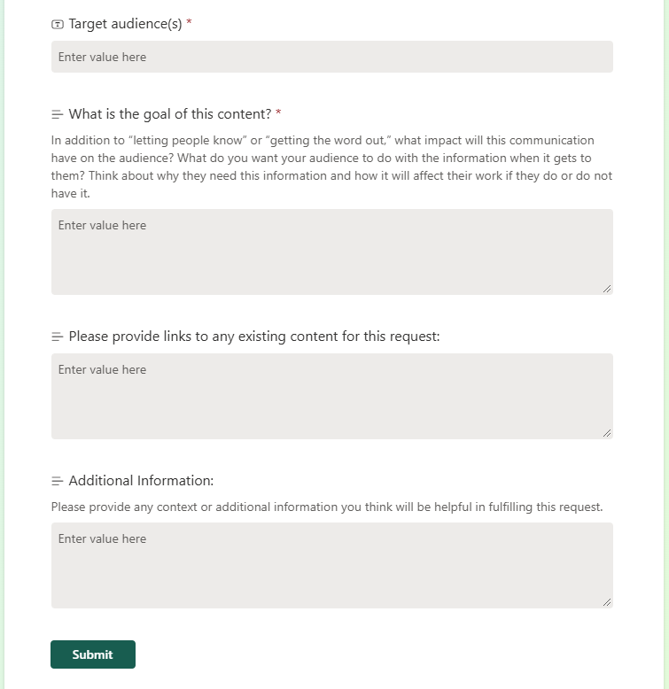
NEW! Communications Support Form
Submit your support request!

Slide 18
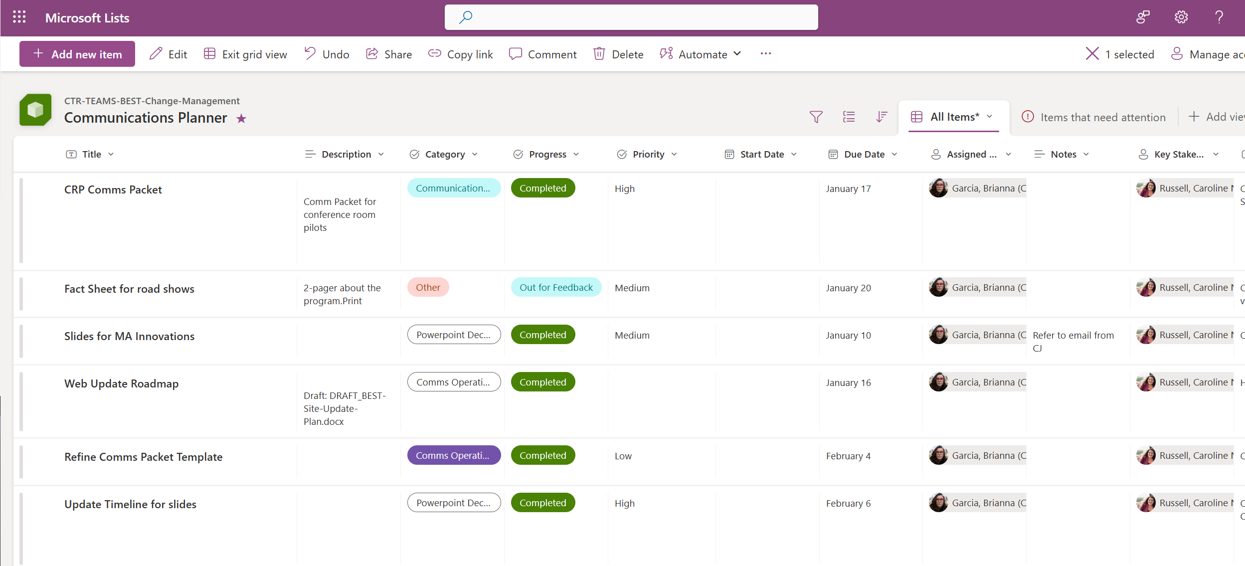
What’s the status of my request?
Requests feed into a MS List which you’ll have access to. You can see notes, progress, who it’s been assigned to, and create filtered views to see only your requests.

Slide 19
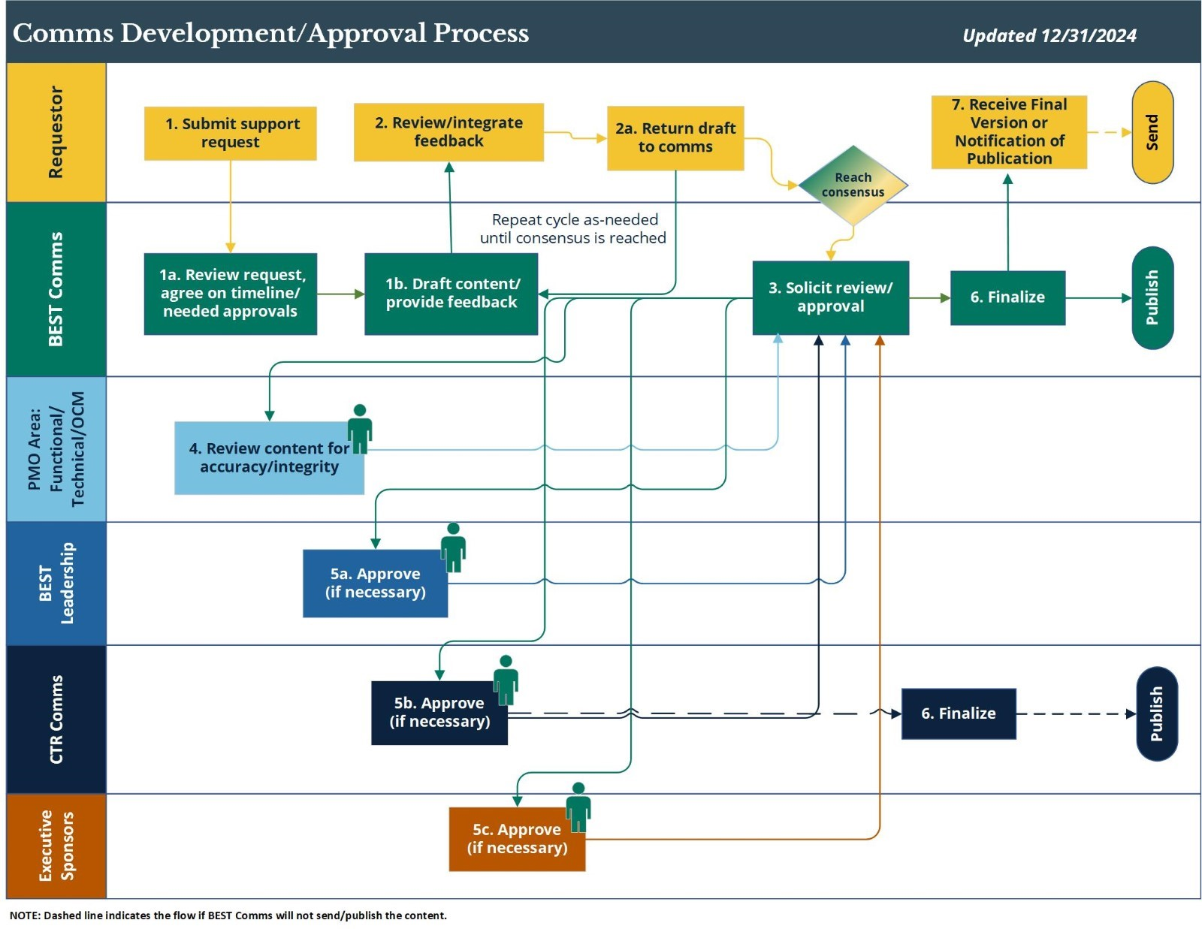
Comms Workflow
The BEST Communications team will offer high-touch support and shepherd content through the approval process.

Slide 20
Comms Timelines
Content Type | Recommended Lead Time
Email | 2 business days
Slide Deck | 5-8 business days
Communications Packet for Upcoming Activity | 4-8 business days initial draft, ~10-15 days total
SharePoint Content | 2-3 business days
Web Copy | 3-5 business days
Please note: The above timelines are estimates and may vary depending on request volume and business needs. The comms team will work with you to establish a timeline for reviews and feedback when you submit your request.

Slide 21
Q&As (FAQs if you must…) for now:
When you get a program-level question from an external stakeholder:
Acknowledge receipt and thank the sender for their question.
Thank you for your question(s). We will work with the team and get back to you shortly.
Forward to Comms, Team Lead, and Transformation_PMO.
(You may draft a response if you would like but you don’t have to!)
Comms will forward the question to the appropriate PMO lead(s) to review.
PMO leads complete review/provide feedback.
Comms notifies original question recipient of approved answer.
BEST Team remember who received the initial question sends the approved response and copies their Team Lead, Comms, and Transformation_PMO

Slide 22
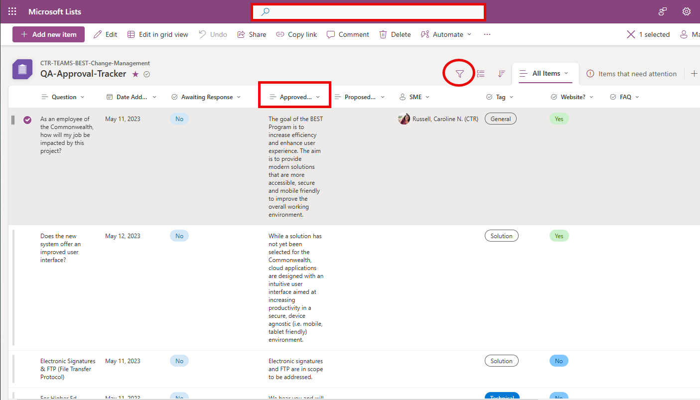

SNEAK PREVIEW! Q&A* Tracker
*Formerly FAQ
UNDER CONSTRUCTION!
One component of the overall Program communications flow!
Still working through how to rollout and fully operationalize this process
Overview
  Comprehensive database of questions & answers gathered from various sources (e.g., working groups, CAN sessions, individual meetings)
  BEST PMO Workstreams will use:
    As “one source of truth” - single repository of questions & answers
    Q&A across workstreams
    View status – draft vs. approved response, posted to website

Slide 23
Reviewers
Reviewer/Stakeholder Group | Level of Review/Responsibilities
Requestor or Content Author | Reach out to communications team as soon as a need is identified. Submit requests via comms support form. SOMETIMES: solicit feedback from PMO leads.* Respond to feedback/questions from other stakeholders.
BEST Comms Team | Assist or lead development/writing Provide in-depth feedback and edits on messaging, content, structure Identify stakeholder groups, coordinate additional review Send/publish content when warranted (program-wide comms)
PMO Leads/Functional Team | Review content for accuracy/alignment with current program status.

Slide 24
Reviewers (cont’d)
Stakeholder Group | Level of Review/Responsibilities
BEST Program Manager | Final sign-off on high-level communications. Low level of review (if Comms has done their job right!)
CTR Comms | Final sign-off on CTR communications. (CTR Weekly Update, CTR websites: macomptroller.org, CTR Intranet, CTR Employee Central) Contributor/Approver/Distributor for some Commonwealth-wide distributions.
Executive Sponsors | Final sign-off on high-level program-wide communications as needed.

Slide 25
Putting BEST to Practice

Slide 26
POP QUIZ! Question 1
Scenario: You’re a Functional Track Lead and you receive a question from a FIE about the timeline for User Acceptance Testing. In a meeting last week, your team lead told you we will start recruiting testers in a few weeks.
Do you need to involve Comms?
YES
Raise Virtual Hand
NO
YES! You should loop in your team lead and Transformation_PMO because this involves a topic outside of your workstream’s day-to-day activities and we want to ensure alignment across Program activities.

Slide 27
POP QUIZ! Question 2
Scenario: You’re a Business Analyst and one of your Interface contacts sends you a message on Teams with a “quick question” about training.
Do you need to involve Comms?
YES
Raise Virtual Hand
NO
YES! Again, this is outside of your workstream and needs to be in alignment across the PMO. In this situation you can direct the person to the Transformation_PMO inbox or email the question yourself.

Slide 28
POP QUIZ! Question 3
Scenario: Last week you were in touch with Treasury (TRE) about their interfaces, and this week a former colleague who is now working at TRE reaches out to ask how work is going and if you wants to catch up some time.
Do you need to involve Comms?
YES
Raise Virtual Hand
NO
NO! You don’t need to involve Comms in casual social interactions. (If the conversation then happens to pivot to interfaces, let them know they can direct questions to Transformation_PMO@mass.gov!)

Slide 29
POP QUIZ! Question 4
Scenario: Your team is hiring, and a recruiter on LinkedIn reaches out to ask you about a role your manager is conducting interviews for.
Do you need to involve Comms?
YES
Raise Virtual Hand
NO
YES! Do not engage! Email Transformation_PMO about the interaction and include screenshots if relevant.

Slide 30
POP QUIZ! Question 5
Scenario: You’re a Readiness Liaison, and a Change Agent from one of your assigned agencies emails you to ask a question about their Readiness Assessment and to suggest a topic they’d like to cover at an upcoming meeting.
Do you need to involve Comms?
YES
Raise Virtual Hand
NO
NO, but… ! Since this is a limited interaction about work specific to your workstream, Comms may not need to be involved, BUT your Team Lead should probably be looped in.

Slide 31
POP QUIZ! Question 6
Scenario: You’re a Trainer helping to develop in-application support tools, and a reporter from the Boston Globe emails you to ask about what you’re doing and what the BEST Program is all about.
Do you need to involve Comms?
YES
Raise Virtual Hand
NO
YES! In this unlikely scenario, do not pass go, do not collect $200, forward directly to Transformation_PMO. (This one would get escalated all the way up to CTR Comms!)

Slide 32
Remember!
When in doubt, fill it (the comms support form) out!
Talk to comms early and often.
We’re here to help, not hinder!
Embrace the pace. We would always rather be getting our messaging aligned a bit too early over finding out about the need for a message at crunch time.
Lottery-proof your interactions! Loop in Transformation_PMO and your team lead in case you hit the jackpot and leave us.

Slide 33

In Conclusion
This presentation was long, and we don’t expect you to come back and re-read it!
Here’s the cliff notes:
Comms is here to help.
If you’re not sure about whether we need to be involved or if you are unclear about any of the processes, just ask!

Slide 34



Questions? Feedback?
BEST Communications Team
How can we improve this presentation?
How can we support your team in understanding the content and processes we’ve discussed today?
Questions or other feedback?
Christine Jacinto
Organizational
Change Management Lead
christine.jacinto@mass.gov
Caroline Russell
Communications Lead
caroline.n.russell@mass.gov
Brianna Garcia
Digital Content &
Communications Coordinator
brianna.garcia@mass.gov
BEST Program Management Office
Transformation_PMO@mass.gov
best.macomptroller.org

